Slide 1
Cost Of Living Project Using Power Bi

Slide 2
Importing Files and understanding data set
The initial steps in my analysis involve importing the data set into Power BI and familiarizing ourselves with its attributes, laying the groundwork for deeper exploration and discovery.

Slide 3
Data Cleaning
1.Handling Missing Data
Identifying and addressing missing values.
2.Checking for Duplicates and Inconsistencies
Identifying and handling duplicates.

Slide 4
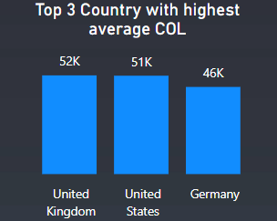
Insight:
The column chart clearly indicates that United kingdom ,United states and Germany are the top 3 countries with highest cost of living.

Slide 5
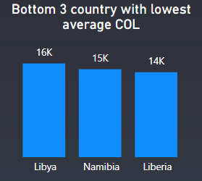
Insight:
The column chart clearly indicates Libya, Namibia and Liberia are the bottom 3 countries with lowest cost of living.

Slide 6
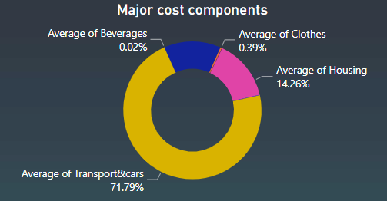
The donut chart clearly indicates that transportation expenses outweigh all other categories, making it the most significant cost factor.
Insight:

